Slide 1
Why graph?

Slide 2


Slide 3
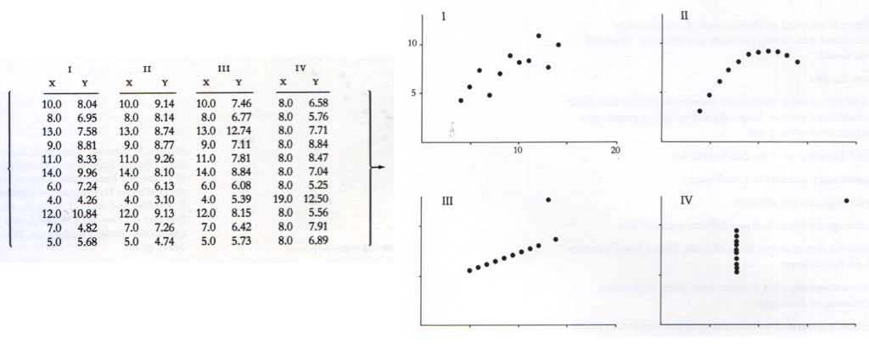
Why graph?
“Anscombe’s Quartet”: for each data set;
N = 11
Mean of X = 9
Mean of Y = 7.5
Variance of X = 11
Variance of Y = 4.1

Slide 4
Why graph?

Slide 5
IN GROUPS:
For each of the three following graphs,
Extract 5 pieces of information.
What information is easy to extract?
What information is difficult to extract?
What could be done to improve the readability of the visualization?

Slide 6
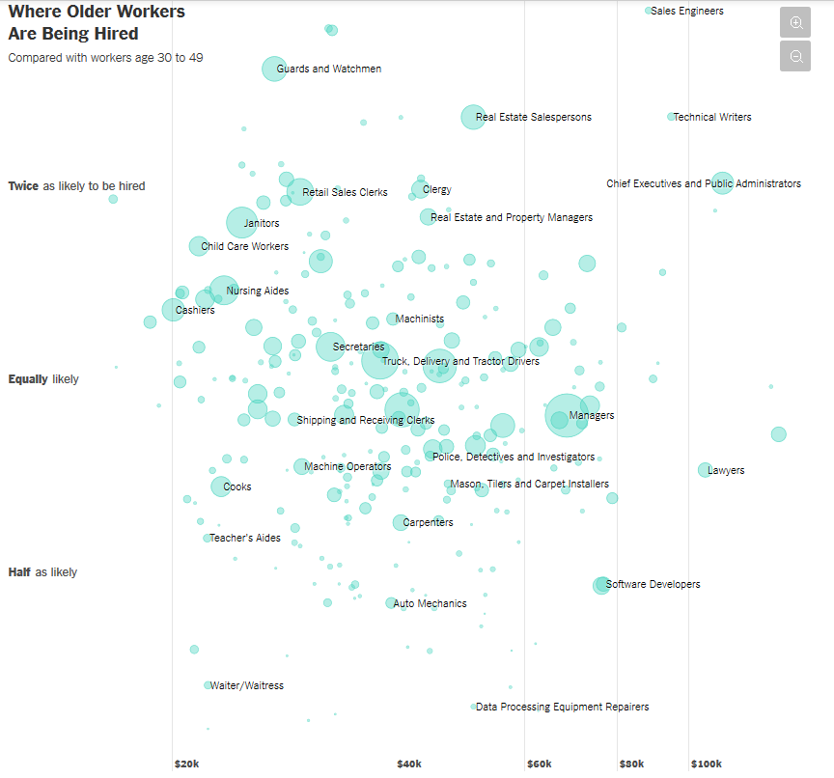
Graph 1
Link

Slide 7
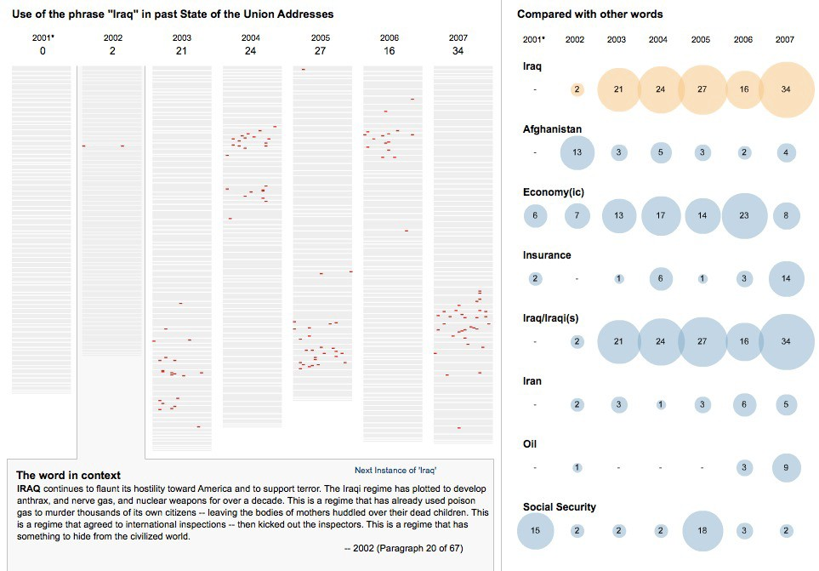
Graph 2
Link

Slide 8
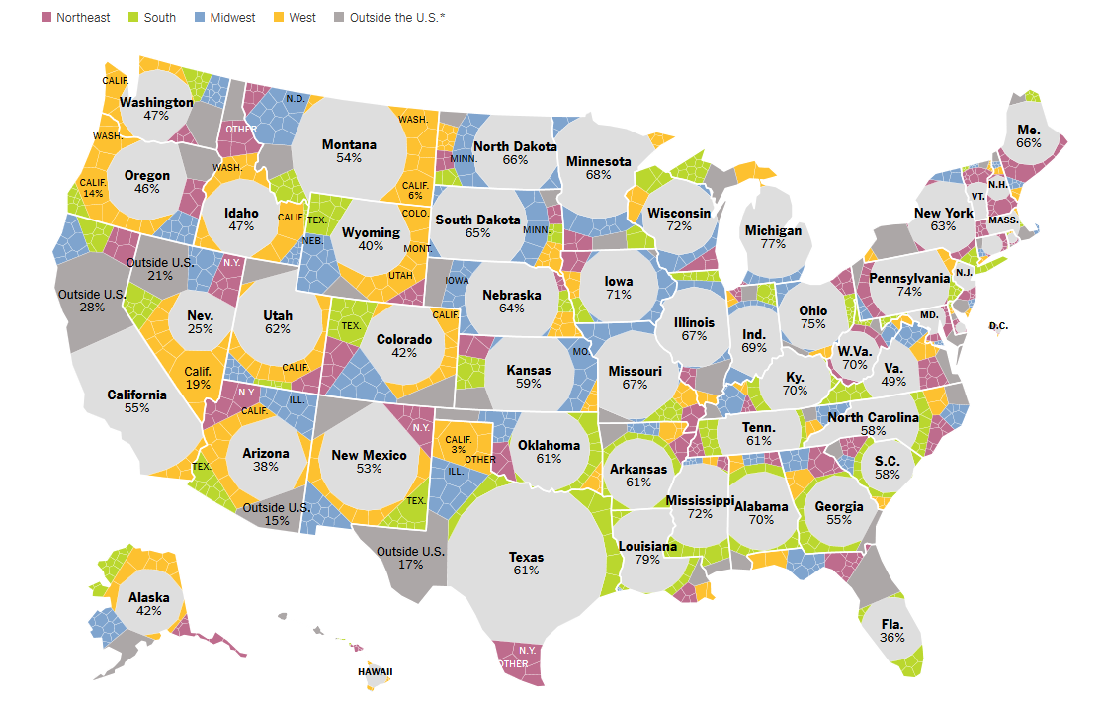
Graph 3
Link

Slide 9
What makes graph work?
…and what makes them fail?

Slide 10

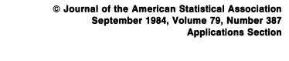
How do we extract information?

Slide 11
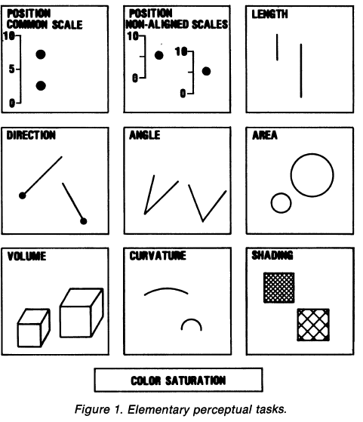
Elementary Perceptual Tasks
Very often, extracting information involves more than one EPT.

Slide 12
Which represents the larger value? Which EPT did you use?
h/t Hadley Wickham

Slide 13
Which represents the larger value? Which EPT did you use?
h/t Hadley Wickham

Slide 14
Which represents the larger value? Which EPT did you use?
h/t Hadley Wickham

Slide 15
HSV: The 3 dimensions of color

Slide 16
Hue
Saturation
Value

Slide 17


Slide 18
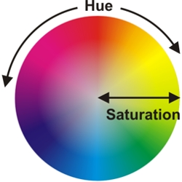

Slide 19


Slide 20
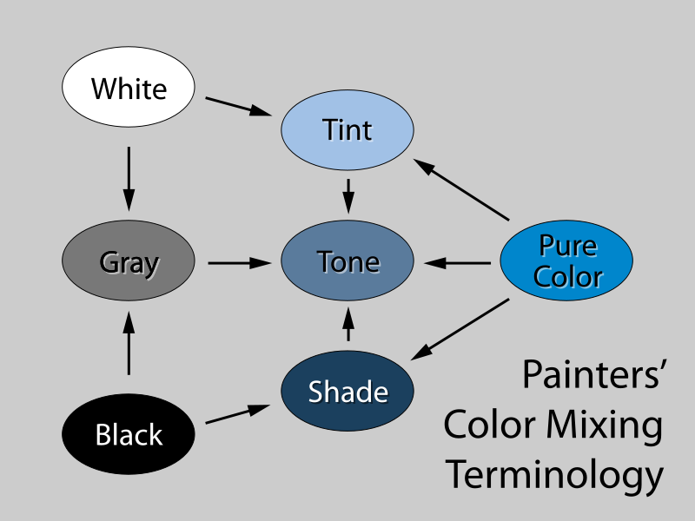
Saturation (aka “color ramp”)
Value
(aka “gray ramp”)

Slide 21
Which represents the larger value? Which EPT did you use?
h/t Hadley Wickham

Slide 22
Which represents the larger value? Which EPT did you use?
h/t Hadley Wickham

Slide 23
Which represents the larger value? Which EPT did you use?
h/t Hadley Wickham

Slide 24
Which represents the larger value? Which EPT did you use?
h/t Hadley Wickham

Slide 25
EPT | Ordered?
Position | Yes
Size (length, angle, volume) | Yes
Saturation (color ramp) | Yes
Value (gray ramp) | Yes
Hue | No
Shape | No

Slide 26
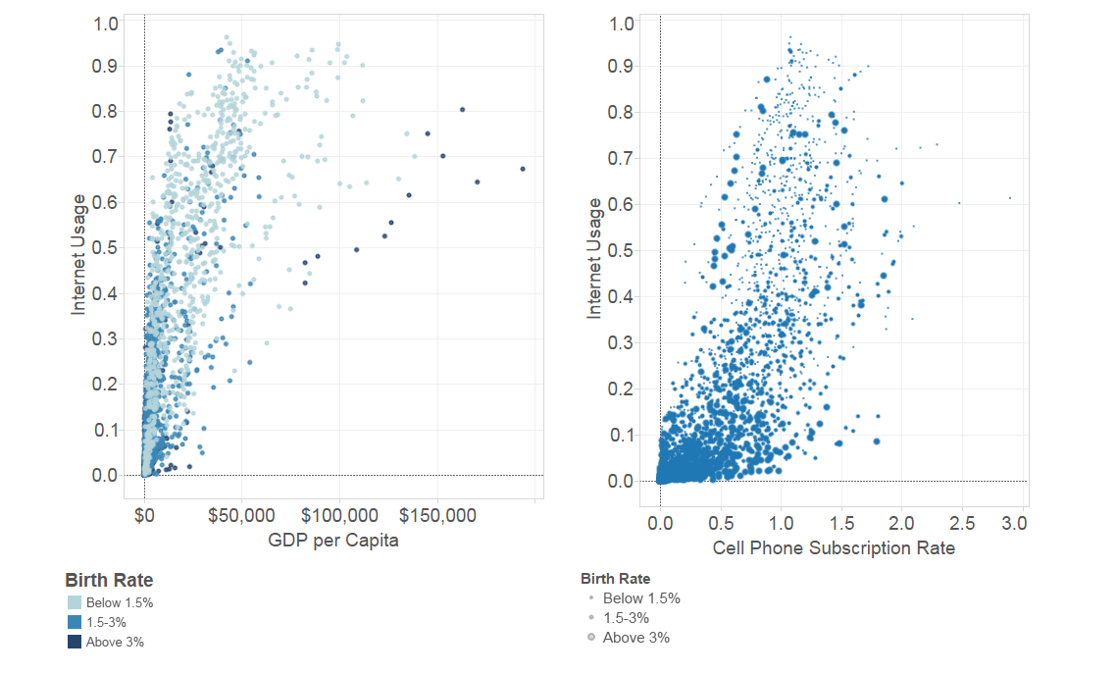
What EPTs do we use to:
Compare the GDP of the 2 circled points?
Compare the internet usage of the 2 circled points?
Determine the nature of association between Internet Usage and GDP?
Determine association between birth rate and GDP?
Determine association between birth rate and cell phone subscription?

Slide 27

Napoleon’s march on Moscow, 1812
“It may well be the best statistical graphic ever drawn” –Ed Tufte

Slide 28
Different EPTs for different data.

Slide 29
Variable types
Quantitative: numeric data
Age, height, weight, time elapsed
Ordering makes sense
Ordinal: categorical data; levels ordered
Letter grade (A, B, C, D, F); Likert scale (strongly agree, agree, disagree, strongly disagree)
Nominal: categorical data; levels unordered
Sex; race; place of birth;

Slide 30
EPT | Ordered?
Position | Yes
Size (length, angle, volume) | Yes
Saturation (color ramp) | Yes
Value (gray ramp) | Yes
Hue | No
Shape | No
Use ordered EPTs for quantitative and ordinal categorical variables; non-ordered EPTs for nominal.
IN GROUPS: Look at Graphs 1-3, and the Napoleon graphic. What are the variables, and their types? Do the EPTs match the types?

Slide 31
Not all EPTs are created equal.

Slide 32
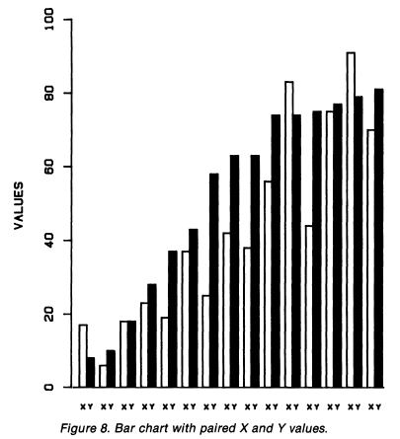
Question: What is the association between X and Y?
What EPTs are you using to extract information?
From Cleveland and McGill

Slide 33
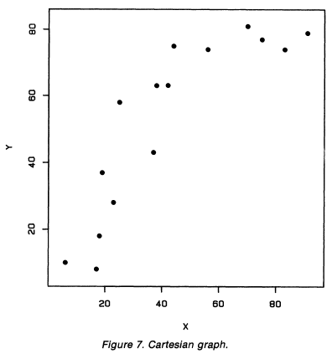
Question: What is the association between X and Y?
What EPTs are you using to extract information?
From Cleveland and McGill

Slide 34
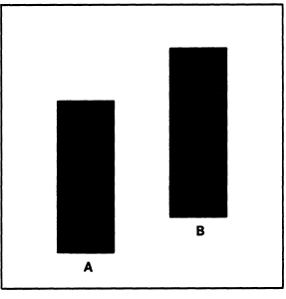
Which bar is tallest?
Which EPT are you using?
From Cleveland and McGill

Slide 35
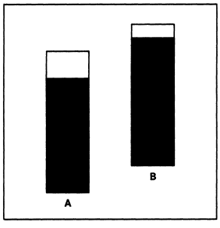
Which bar is tallest?
Which EPT are you using?
From Cleveland and McGill

Slide 36
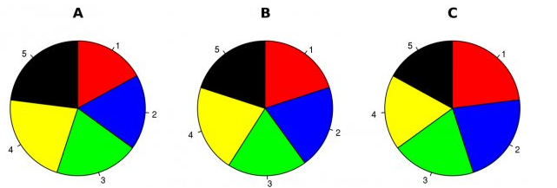
Hypothetical election data on 5 candidates at 3 time points (A, B, C). Which EPTs do you use to answer the following:
At Time A, is Candidate 5 doing better than Candidate 3?
Who improves most between times A and B, Candidate 2 or Candidate 4?
Who has the most momentum in the race?
h/t Walter Hickey at Business Insider

Slide 37
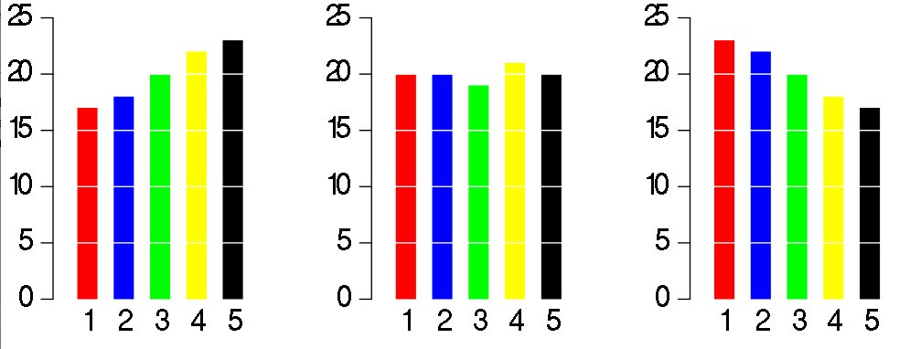
Same data, different graph. Now what EPTs do you use?
At time A, is Candidate 5 doing better than Candidate 3?
Who improves most between times A and B, Candidate 2 or Candidate 4?
Who has the most momentum in the race?
h/t Walter Hickey at Business Insider

Slide 38
Back to Cleveland and McGill…what is the relative area of a to b?
a
b

Slide 39
What about now?
a
b

Slide 40
What about now?
a
b

Slide 41
What about now?
b
a

Slide 42
What about now?
b
a

Slide 43
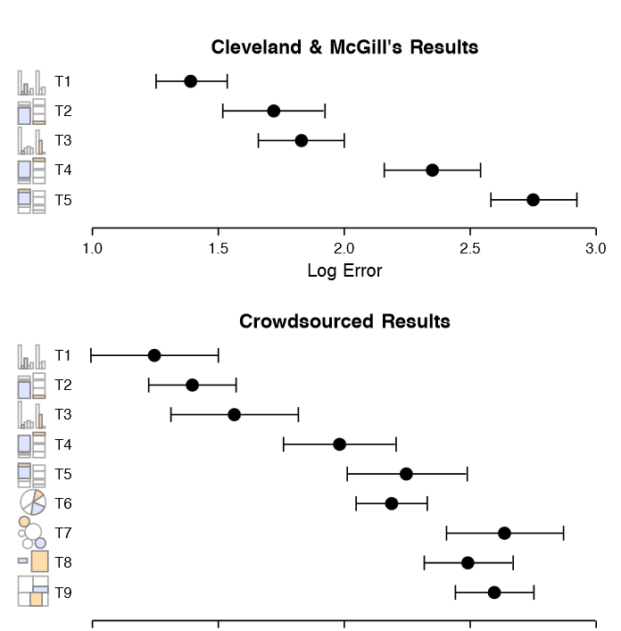
J. Heer and
M. Bostock. Crowdsourcing graphical perception: Using mechanical turk to assess visualization design. In CHI 2010, 2010.

Slide 44
Moral
Make important comparisons easy
Exploit our most efficient EPTs

Slide 45
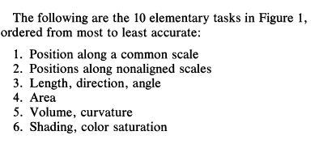
Not all EPTs are created equal:
From Cleveland and McGill, p536

Slide 46
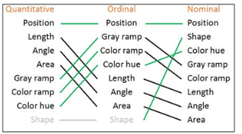

Not all EPTs are created equal:
Value
Saturation
Hue
From Ben Jones, Visualizing Data with Tableau, p9

Slide 47

Ed Tufte: the EPT minimalist
Professor Emeritus: Yale University
Statistician, political scientist, computer scientist, power point hater
Early pioneer of data visualization theory

Slide 48
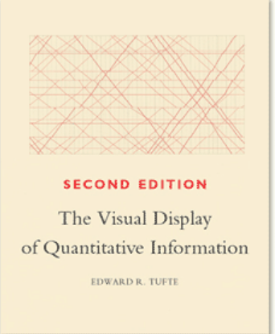
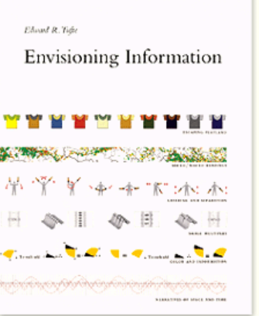
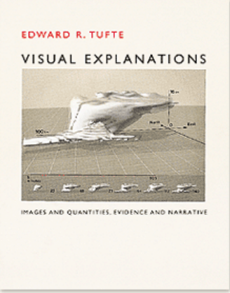


Slide 49
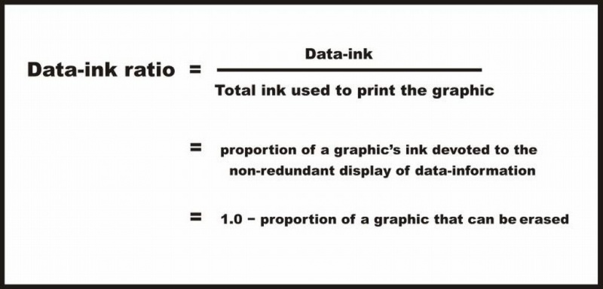
Data-to-Ink Ratio
Ratio of Data-Ink to non-Data-Ink
The proportion of Ink that is used to present actual data compared to the total amount of ink (or pixels) used in the entire display:
“Good displays” = displays with D-t-I ratios close to 1
http://www.infovis-wiki.net/index.php/Data-Ink_Ratio

Slide 50
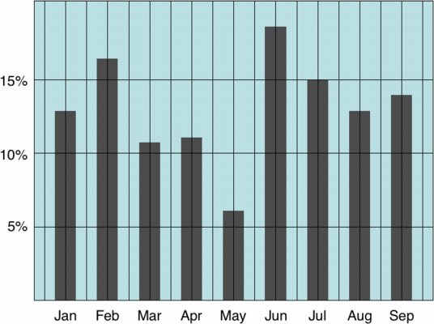
Low data-to-ink ratio
http://www.infovis-wiki.net/index.php/Data-Ink_Ratio

Slide 51
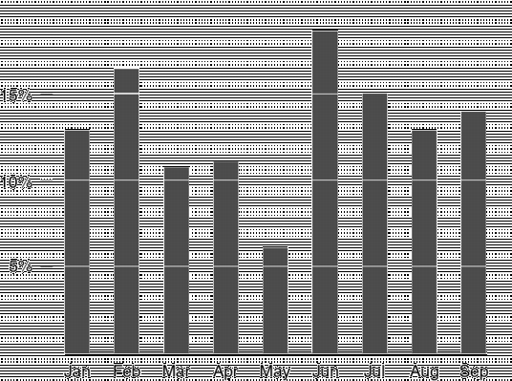
High data-to-ink ratio
http://www.infovis-wiki.net/index.php/Data-Ink_Ratio

Slide 52
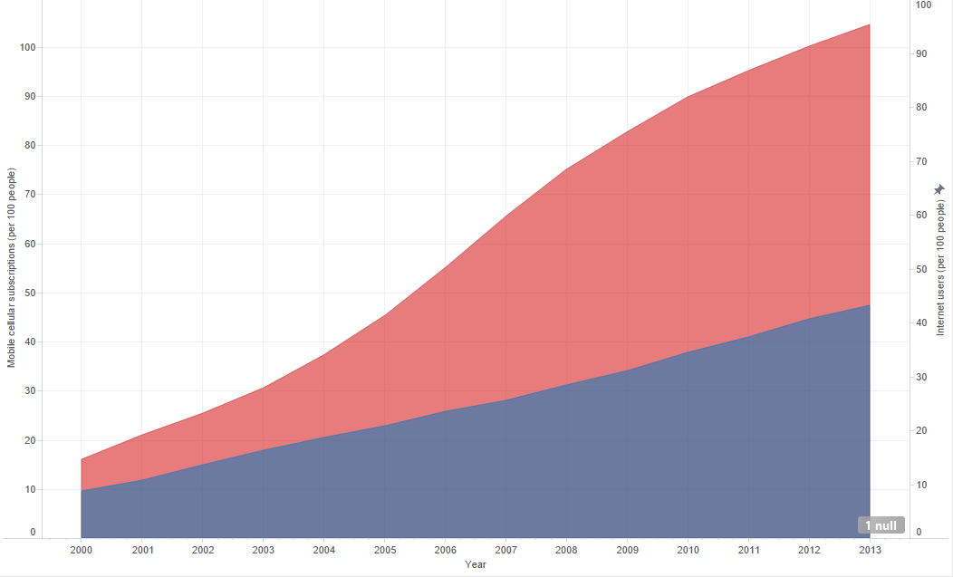
Low data-to-ink ratio
https://public.tableau.com/profile/silas.bergen#!/vizhome/WorldBankData_14/Story1

Slide 53
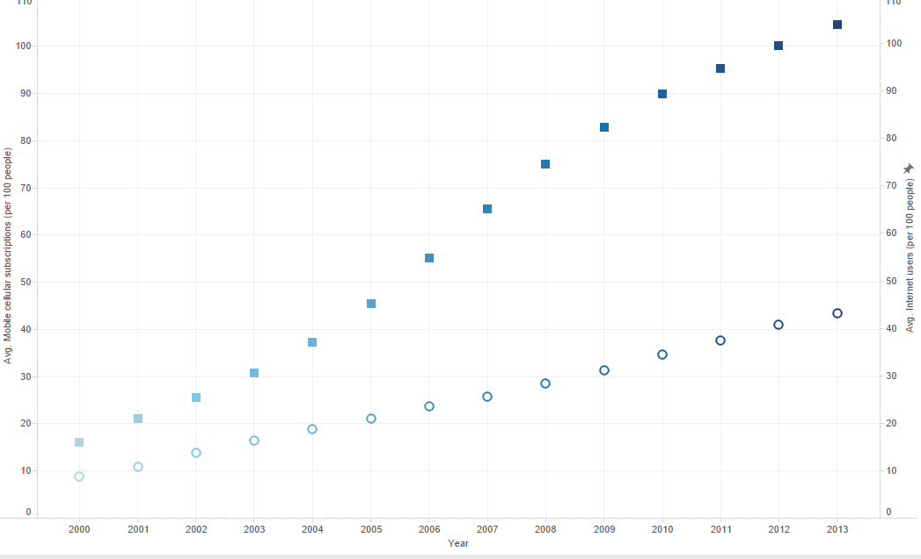
High data-to-ink ratio
https://public.tableau.com/profile/silas.bergen#!/vizhome/WorldBankData_14/Story1

Slide 54
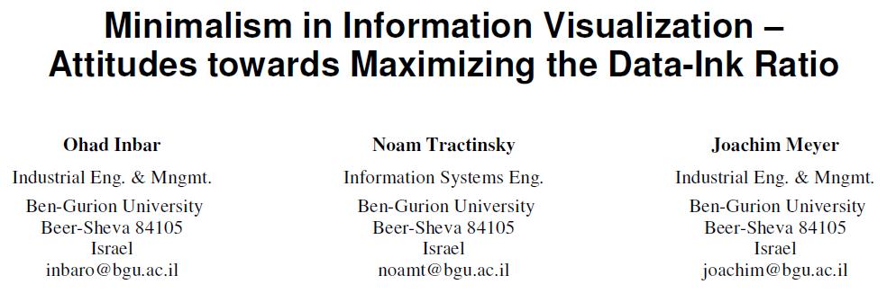
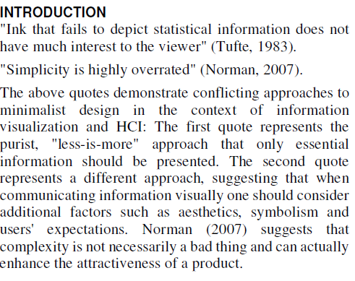

Slide 55
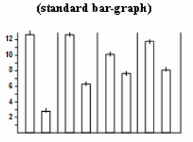
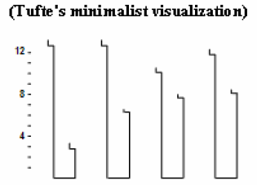
87 undergraduate students asked to decide which is more “beautiful”, “clear”, and “simple”.
Graphs taken from Tufte’s Visual Display of Quantitative Information (1983)
Which EPTs are in play for each graph?

Slide 56
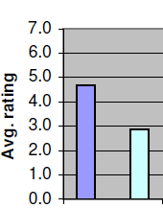
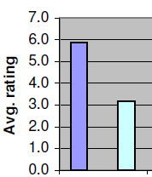
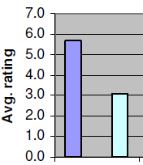
Beautiful
Clear
Simple
Standard
Tufte
Standard
Tufte
Standard
Tufte

Slide 57

Data-to-ink ratio
Minimalism
YOU
Elegance/
attractiveness

Slide 58
For the following visualizations…
What message(s) is the graph trying to communicate?
What are the variables? Quantitative/Ordinal/Nominal?
Which EPTs are used, and are they effective?
Could the visualization be improved? If applicable, sketch/describe an improved visualization.

Slide 59
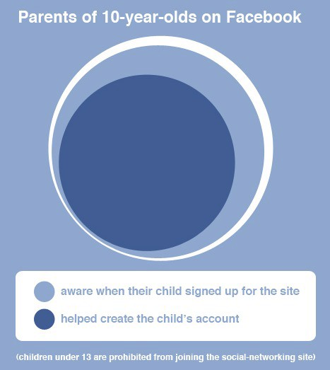
h/t http://www.dreamsystemsmedia.com/blog/index.php/social-media-statistics-of-the-day/

Slide 60
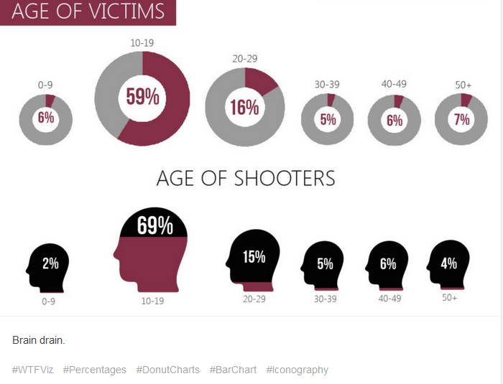
h/t WTFViz

Slide 61
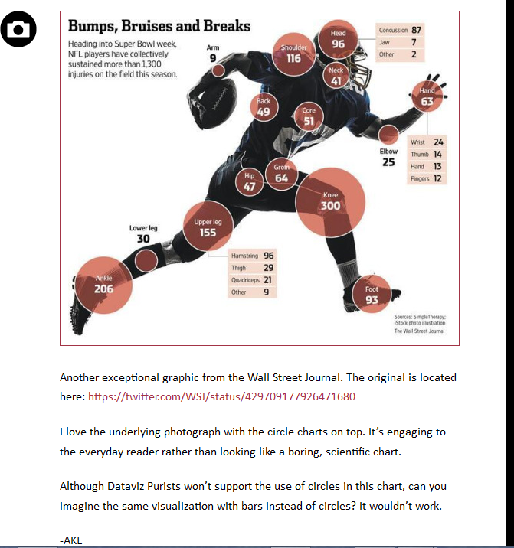
h/t ThumbsUpViz

Slide 62
Note on last graph…
h/t ThumbsUpViz

Slide 63
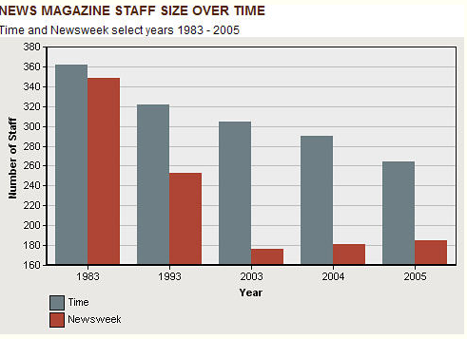
Source: Perceptual Edge

Slide 64
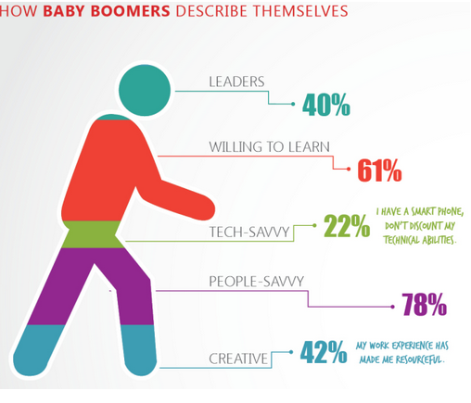
h/t WTFViz

Slide 65
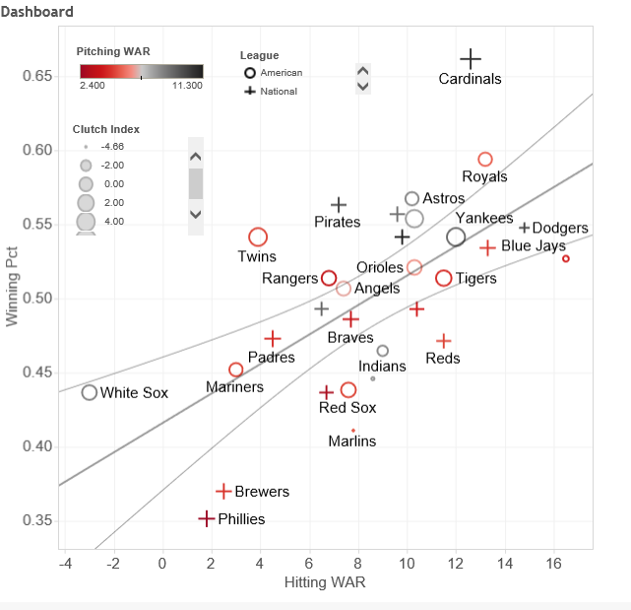
Link

Slide 66


Slide 67
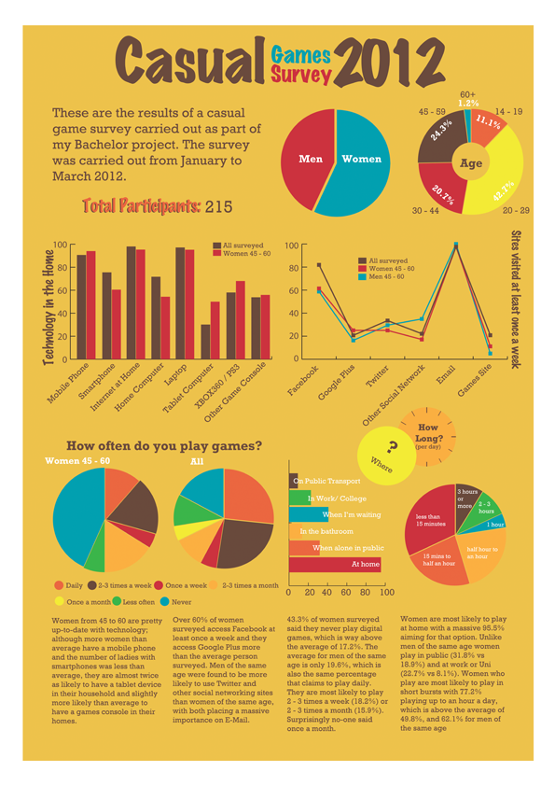
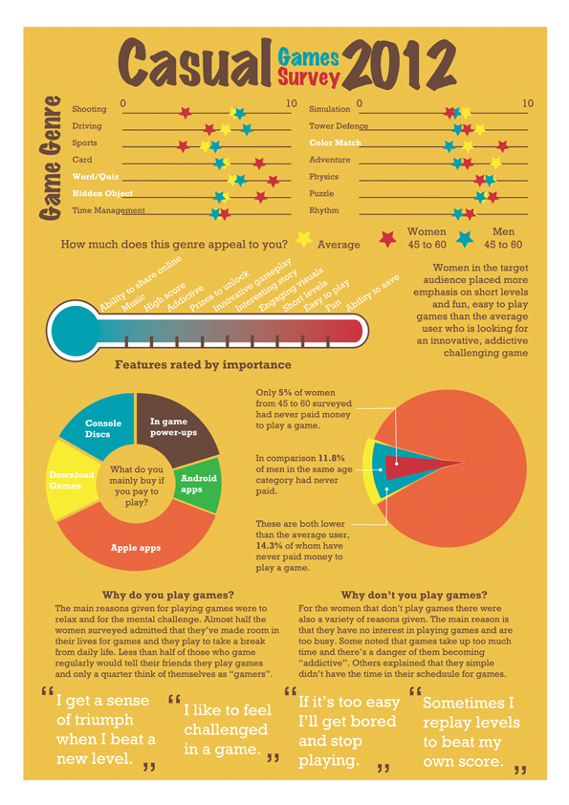
http://hazel-ok.blogspot.com/

Slide 68
Additional principles

Slide 69
1. Know your message:
It is not the same as information

Slide 70
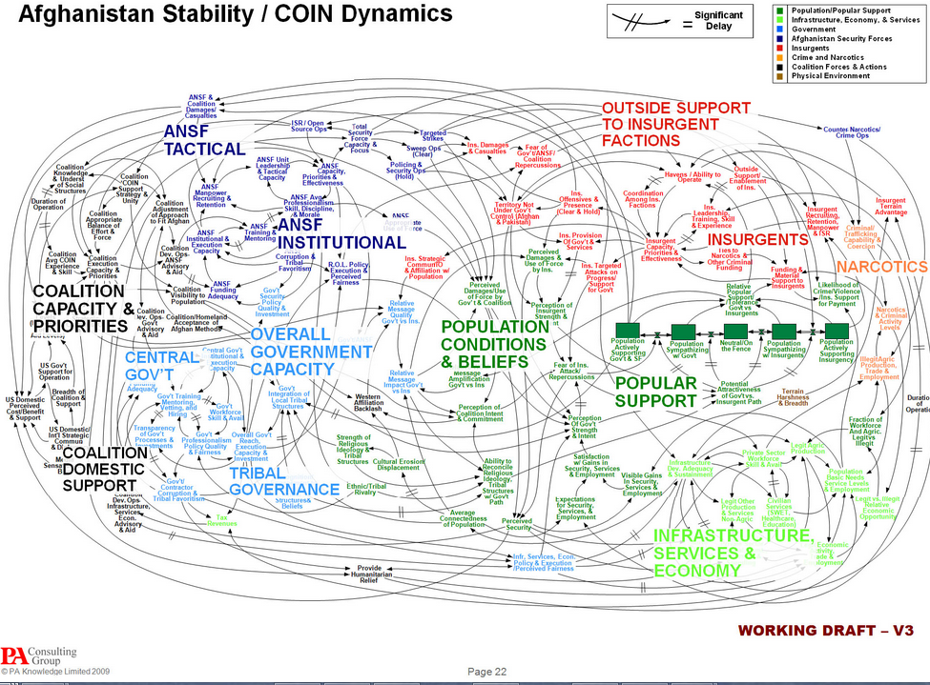
Lots of information…but what’s the message?
(“Waaaaah, spreading Western culture is hard”?)

Slide 71
2. Use the right data

Slide 72
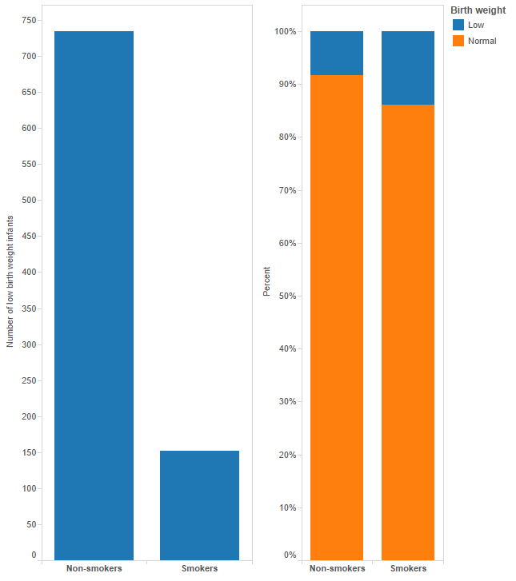

Slide 73
3. Design for aesthetics
…while avoiding “chart junk”

Slide 74
Some tips for aesthetics
Avoid poor color schemes
Watch the axes and labels: Readable? Consistent?
Use the same fonts
Don’t accept software defaults

Slide 75
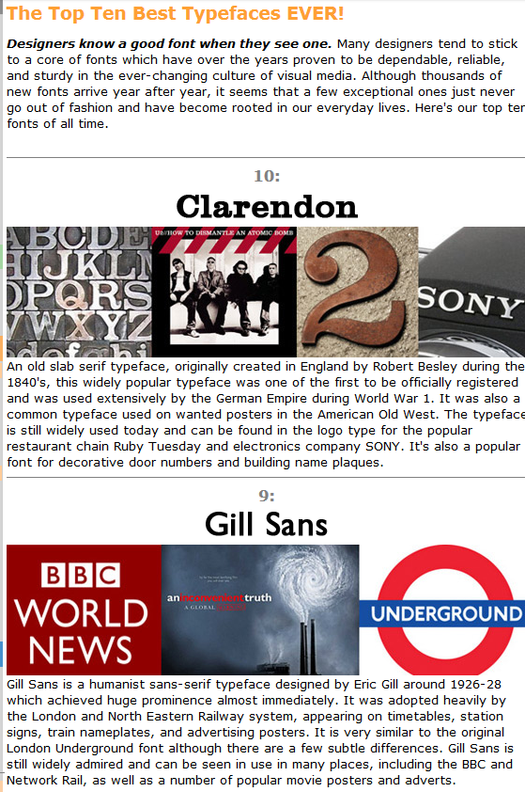
The best and worst fonts:
Link 1
Link 2

Slide 76
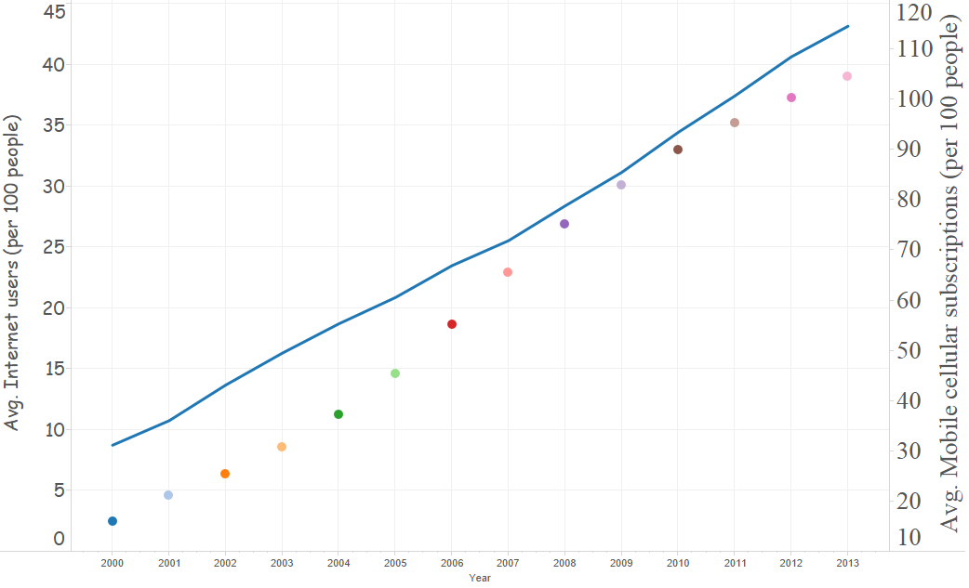
Find the aesthetic perks and pitfalls

Slide 77
4. Don’t lie

Slide 78
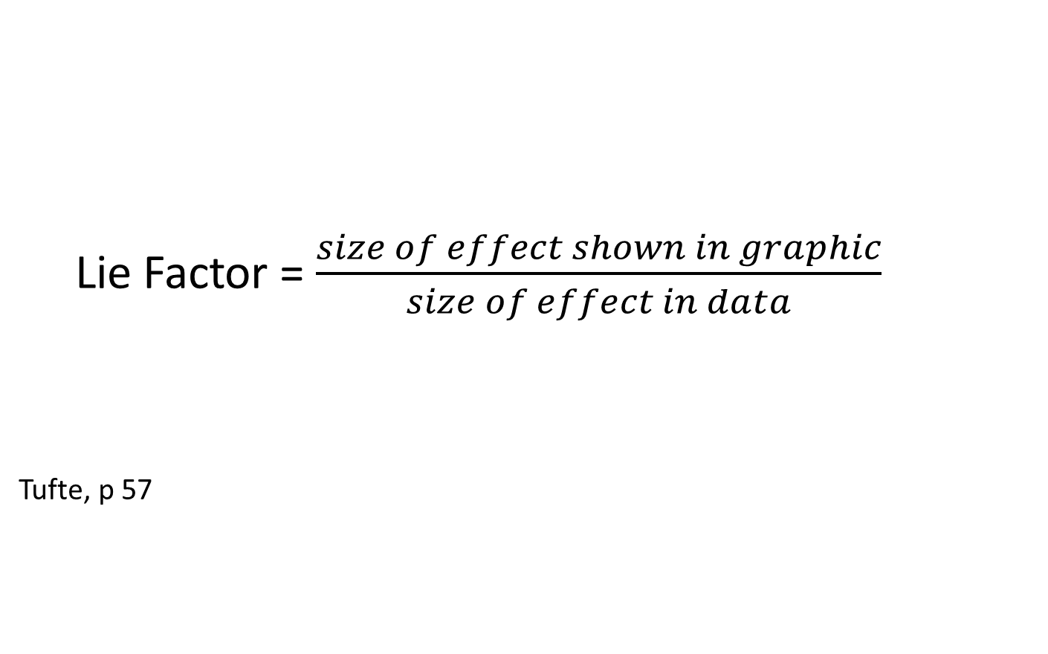
Lie Factor = $\frac{size of effect shown in graphic}{size of effect in data}$
Tufte, p 57

Slide 79
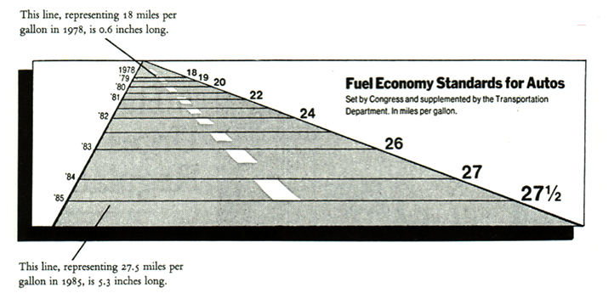
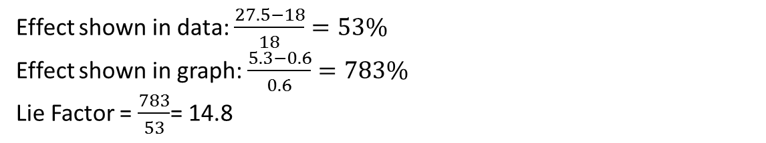
Effect shown in data: $\frac{27.5−18}{18}=53\%$
Effect shown in graph: $\frac{5.3−0.6}{0.6}=783\%$
Lie Factor = $\frac{783}{53}$= 14.8

Slide 80
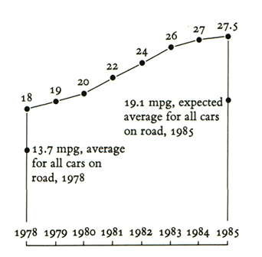

Slide 81
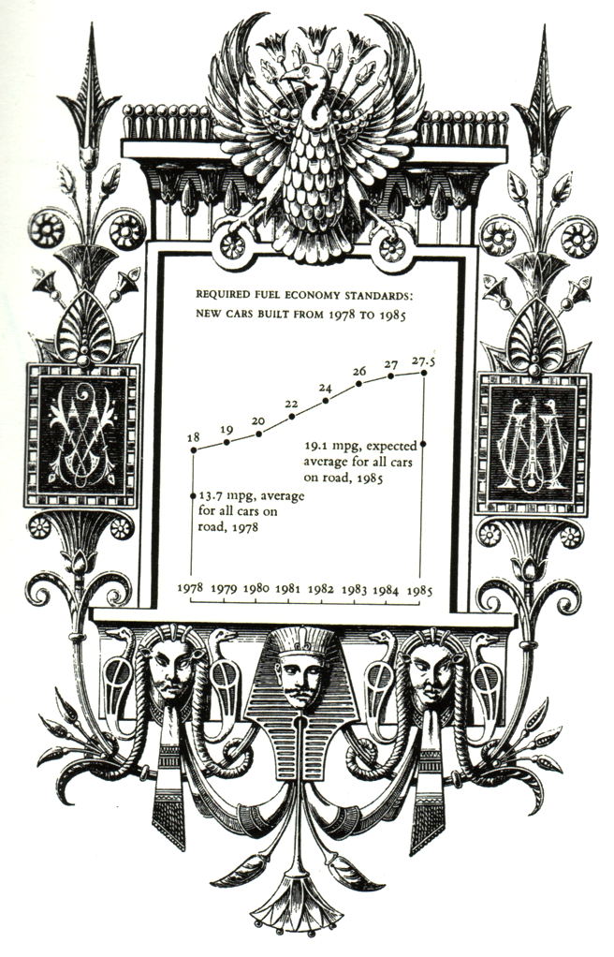
“Many decorations but no lies”:

Slide 82


Data effect = $\frac{43.49−1.53}{1.53}=27.4$

Slide 83

The curse of the 3D chart:
½ in.
1.25 in.
1/16 in.
Do we compare:
Volume? (Lie Factor = ____ )
Height? (Lie Factor = _____, esp bad because it should be = 1! 3D trickery skews the heights)

Slide 84


Slide 85

Source

Slide 86
Tufte’s Principles of Graphical Excellence
Graphical excellence is the well-designed presentation of interesting data – a matter of substance, of statistics, and of design.
Graphical excellence consists of complex ideas communicated with clarity, precision, and efficiency.
Graphical excellence is that which gives to the viewer the greatest number of ideas in the shortest time with the least ink in the smallest space.
Graphical excellence is nearly always multivariate.
And graphical excellence requires telling the truth about data.
Tufte, p 51

